Slide 1
Service Oriented Architecture

Slide 2
Defination
Service-Oriented Architecture (SOA) is a software design approach that structures applications as a collection of loosely coupled, reusable, and interoperable services. In SOA, services are self-contained units of functionality that can be accessed and used independently, either within the same application or across different applications and platforms.

Slide 3
SOA Design Principles
1.Loose Coupling: Services are designed to be independent of each other, allowing them to be modified, updated, or replaced without affecting other services.
2.Reusability: Services are designed to be reusable in different contexts and applications, promoting efficiency and reducing development time.
3.Interoperability: Services are designed to work together seamlessly, regardless of the technology stack or platform they are implemented on.
4.Scalability: SOA allows for the scaling of individual services independently, making it easier to handle changes in demand and workload.
5.Composability: Services can be combined and orchestrated to create complex business processes and applications.

Slide 4
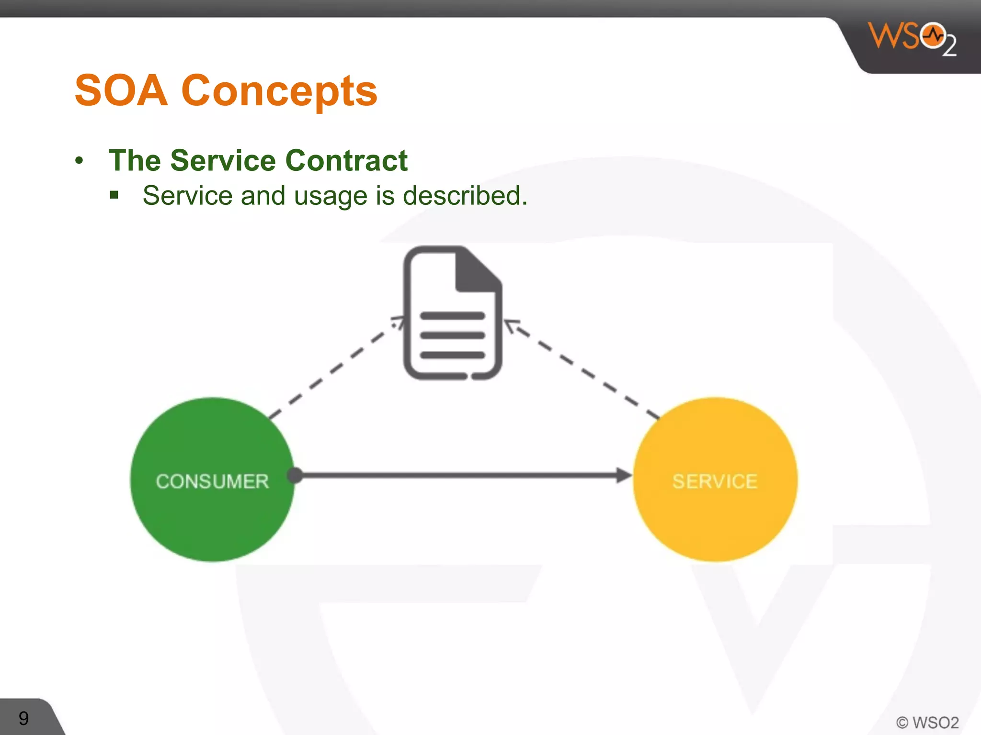

Slide 5
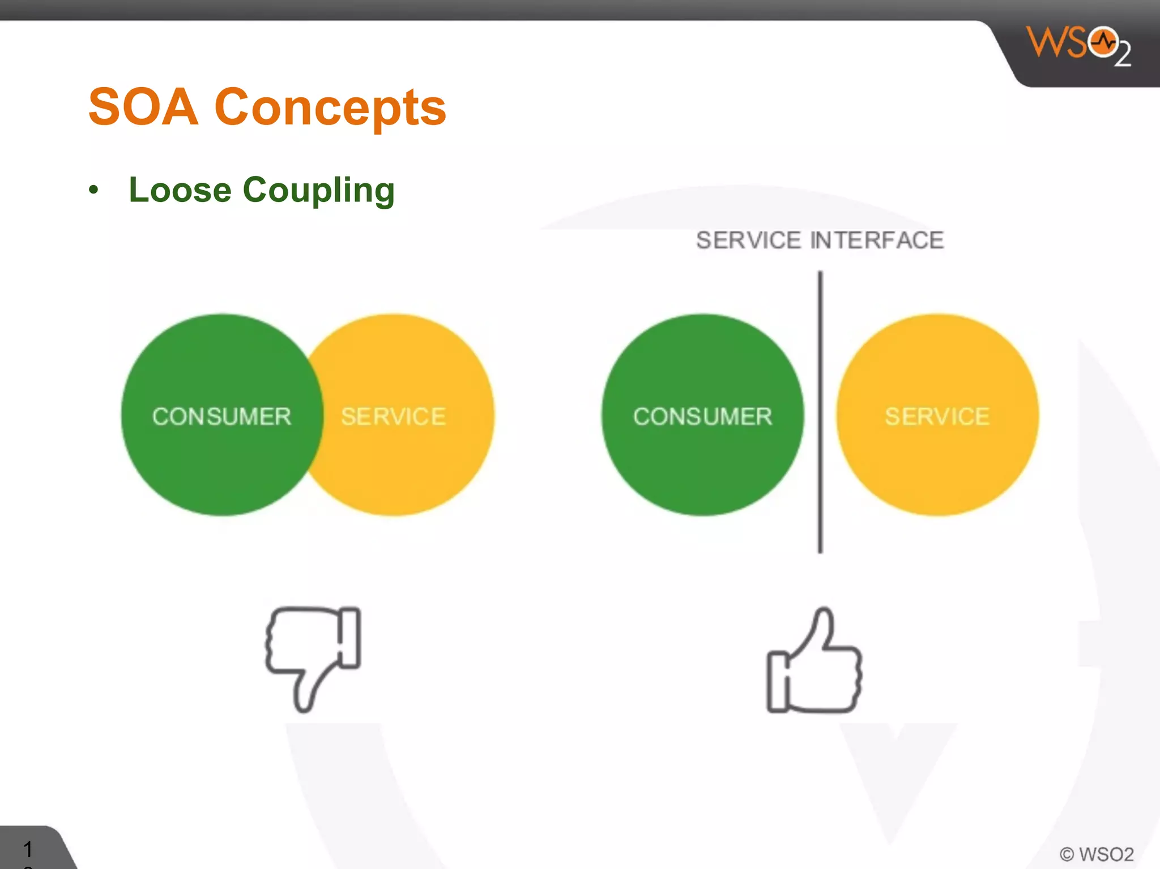

Slide 6
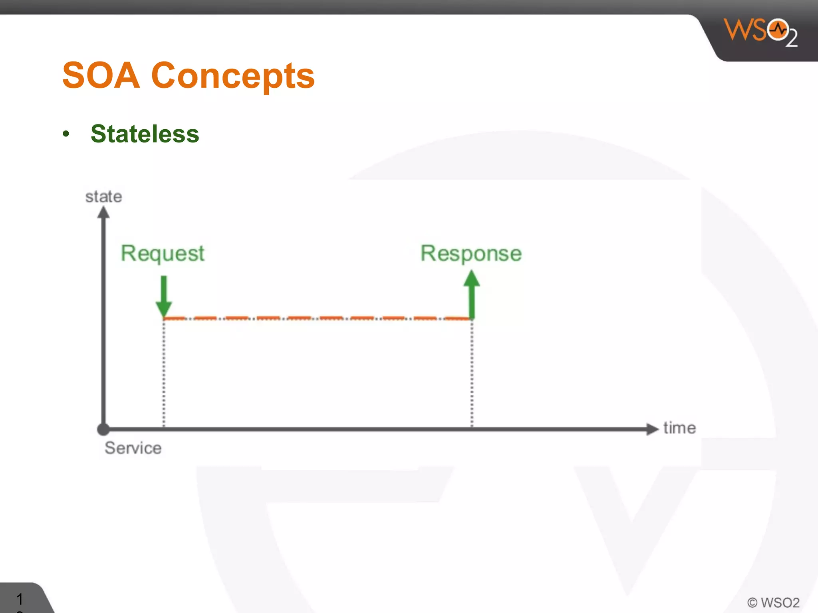

Slide 7
Technologies
SOA Implementation Technologies
•Web services
•RESTful services
•Message-oriented middleware
•Service registries

Slide 8
Future Trends in SOA
•Microservices architecture
•Cloud-native applications
•API-driven development

Slide 9
Conclusion
SOA promotes a modular and flexible approach to software development, enabling organizations to build agile and adaptable systems that can easily evolve and integrate with new technologies and business requirements.

